Slide 1

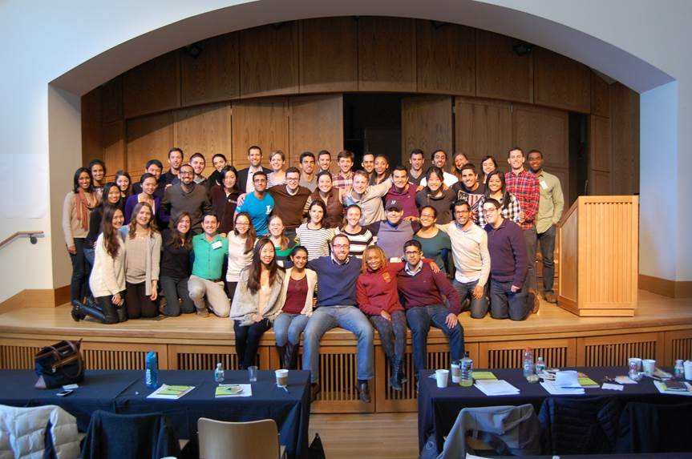

NONPROFIT BOARD FELLOWS
2016-2017 Information Session
Notes:
Intro: Thank you for coming, and Hi, we’re Gizelle & Dan, and this is who we are and how we come to this work
Transition: The NBF is housed in the Wharton Leadership Program…so what’s that?

Slide 2
Agenda
Executive Committee Introductions
Program Overview
Roles
Fellowship Overview & Commitment
Selection
Current Fellows
Questions

Slide 3


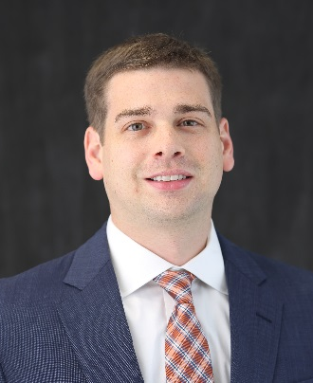
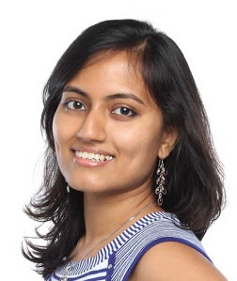
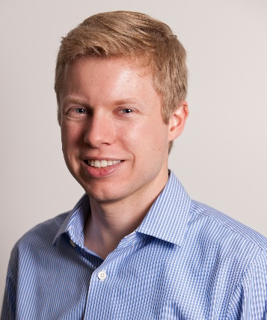
NBF Executive Committee
Dan Kaufman
Associate Director, NBF
Gizelle Clemens
Program Coordinator, NBF
Grant Kieffer
WG ‘17
Tanya Sen
WG ‘17
Jonathan Tugman
WG ‘17

Slide 4
Wharton Leadership Program Mission
“
To develop leaders who act with a deeper understanding of themselves, their organizations, and their communities, and contribute positively to the growth of each.
“

Slide 5
NBF Program Overview
Mission
  To advance the development of MBA and JD students who want to be future civic leaders.
Program Components
  Training
  Placement
  Community building
  Ongoing role support

Slide 6
Executive Committee Role
Have previous board experience
Trained facilitators and peer coaches
Shape program through
  recruitment & selection
  chairing a subcommittee
  development of Board Fellows community culture
Coach and facilitate a “pod” of Board Fellows through challenges in monthly meetings and one-on-ones – e.g., managing board conflicts, role discussions, etc.

Slide 7
Board Fellow (“BF”) Role
14 month commitment (March 2016 – graduation)
Time commitment
  1st year: 25-30 hours total
  2nd year: 10-15 hours/month
Expectations for Fellows
  Participate positively with partner board and organization as a visiting board member;
  Contribute actively to the board fellows community as a board fellow;
  Engage purposefully in personal development.
Notes:
What happens at Mastermind meetings?
Two things. The first is that we bring in experts to present on topics pertinent to board service. And second we provide Fellows the opportunity have structured, peer-led conversations with other Fellows who are serving similar organizations (based on service focus, budget size, etc.)
What happens at pod meetings?
Pod meetings adapt to the interests and needs of the Fellows, and are led by BFCs. These meetings offer Fellows the opportunity to discuss their experience, reflect on challenges and successes, and share best practices.

Slide 8
Board Fellow Commitment
Selected students sign a contract and must meet the following requirements:
Active Campus Participation
Class of 2016 Kick-off in March
One-on-Ones with EC: to discuss goals, matching, etc.
Spring Training Sessions
  1 full day, 4 evening sessions
All-Fellows Meetings with entire BF community
  3rd Tuesday of each month, September-April
Monthly Pod Meetings
Subcommittee meetings
Participate actively in the fellow community
Attendance is mandatory. Students may be removed from the program if terms of the agreement are not upheld.
Notes:
Attendance is mandatory. If you’re not willing or unable to prioritize this program, there are other great ways to get involved in the non-profit community.
This is one of the Leadership Office’s few external-facing programs and students are the face of the program, so the office takes these commitments seriously

Slide 9
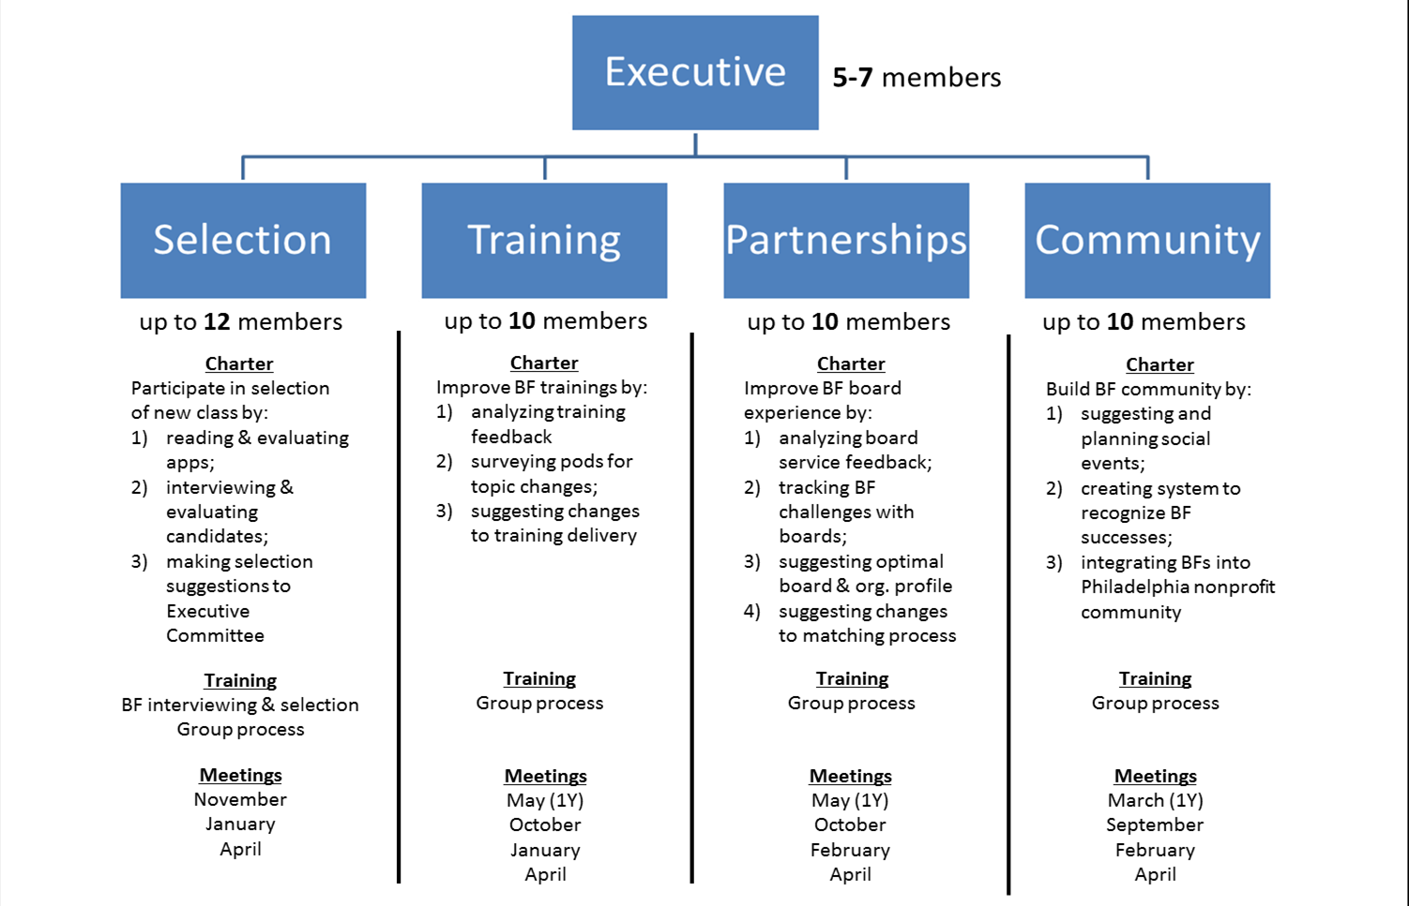
Subcommittee Structure

Slide 10
Board Fellow Commitment
Selected students sign a contract and must meet the following requirements:
Active Non-Profit Participation
All board meetings and subcommittee meetings
Follow through on all commitments made to the non-profit in a timely manner
Attendance is mandatory. Students may be removed from the program if terms of the agreement are not upheld.
Notes:
Attendance is mandatory. If you’re not willing or unable to prioritize this program, there are other great ways to get involved in the non-profit community.
This is one of the Leadership Office’s few external-facing programs and students are the face of the program, so the office takes these commitments seriously

Slide 11
Why Apply?
Service
Gain valuable community leadership experience
Learn about non-profit governance through trainings, workshops, and expert speakers
Apply your business knowledge to a non-profit setting
Community
Engage with a cohort of 40 like-minded students sharing similar experiences
Make connections that strengthen Philadelphia’s non-profit ecosystem
Leadership
Serve as an ambassador of Wharton (only externally facing Fellowship)
Develop skills related to influence, teamwork, communication, diplomacy, and emotional intelligence

Slide 12
Selection Criteria
Humble approach to service
Passion for service
Commitment to diversity
Resilience & Adaptability
Comfort with Ambiguity

Slide 13
Nonprofit Placement
The Leadership Program works to develop and maintain partnerships with 85 participating nonprofit organizations
Boards range in areas of focus, lifecycle stage, and size
Placements are based on students’ interests in the missions of the nonprofit organizations
  Students are asked to select 8 potential organizations
  A critical factor to a successful match in this program and in future involvement is that you are passionate about the mission
We do our best to match people to their preferences but cannot guarantee that you will get your first choice
Notes:
We do our best to match people to their preferences but cannot guarantee that you will get your first choice.

Slide 14




Board Fellow Experiences
Krishna Deva, Career Wardrobe
Laura Minskoff, Opera Philadelphia
Tim Racine, Freedom Prep Charter School
Joyce Chai, Community Partnership School

Slide 15
Key Dates
  Application due Monday, February 1 at 5:00pm
    Submit online through ApplicantStack
    Technical difficulties? Call 215-748-8768.
  Invitations to interview will go out February 9th (9pm)
  Interview sign ups by 5pm on February 10th
  Interviews will be held February 12th-16th
  Decisions will be announced before Spring Break
  All fellows MUST be able to attend the spring trainings (dates announced with interview invite)

Slide 16
Board Fellow Application
Written application submitted online
  Three essay questions, 750 word limit
  Applications are read blind.
Due 5:00 PM February 1, 2016
  LATE APPLICATIONS will NOT be accepted.
  If the internet breaks, call 215-746-8768 before the deadline.
Some applicants will be invited for interviews
  An individual must be interviewed in order to be selected as a Fellow.
  45-minute behavioral interview
The new class will be announced before Spring Break

