Slide 1
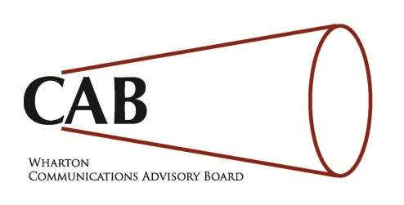
Wharton Communications advisory board (CAB) recruitment information document

Slide 2
Our Mission
To develop and implement ventures, events, presentations and seminars that lend themselves to the broad concept of communication – interpersonal, inter-team, cross-cultural and non-verbal. We recognize the crucial importance of core communication competencies to a top-notch business education and develop effective communication skills as part of our education as “tomorrow’s leaders.”

Slide 3
What we do
We are a Wharton Undergraduate division-sponsored student organization which hosts a number of communications-driven events for the Wharton student body. However, any student in the Penn community is free to attend our events.
We plan and host events for a number of interest groups including international students as they prepare for the American classroom, freshmen as they prepare for status reports in their MGMT100 class as well as sophomores and juniors as they prepare to interview for summer internships.

Slide 4
Calendar of Events
We plan and host a number of Communications-driven events over the course of the academic year including the following:
Fall
Class Participation Workshop
Public Speaking & Non-Verbal Communication
Spring
Interview & Resume preparation with a senior mentor
Wharton Communications keynote
Negotiations Workshop
Dress for Success
Atypical Alumni presentation
For further details on any of these events, visit our website

Slide 5
The Recruitment process
Our recruitment process is aimed at identifying high-performing, driven and committed freshmen and sophomores who have a passion aligned with that of our mission. Individuals who tend to perform well during our two rounds of interviews tend to be confident, creative and enthusiastic about the prospect of serving the Wharton community
The recruitment process takes place during the spring and consists of two interviews; a thirty-minute first round interview with one to two CAB members and a 30-minute final round interview with the co-chairs of the Communications Advisory Board.

Slide 6
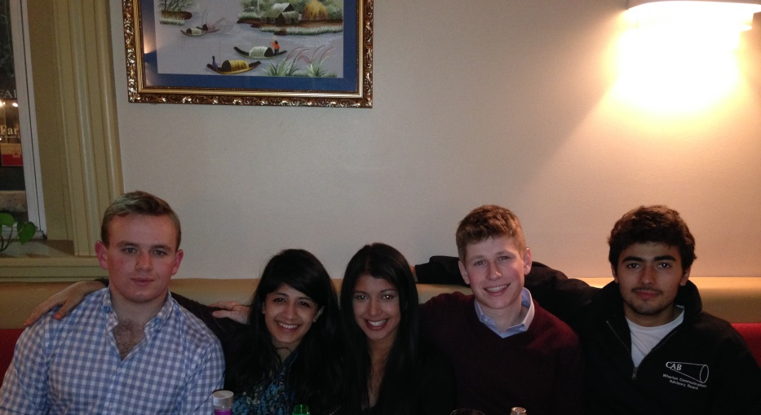
The CAB family
Comprised of probably the most diverse and talented people you will meet in Wharton
Intimate, small and close-knit (only 18 members across all four classes)
Regular social events
Lineage system for inter-class cohesion
Alumni network with multiple touch points in a number of industries
Bios of current CAB members

Slide 7
Questions?
If you have any questions feel free to get in contact with either of the Co-Chairs:
Aditi Srinivas (aditisr@wharton.upenn.edu)
Tatenda Mpofu (tatenda@wharton.upenn.edu)

